Slide 1
Digesting an Open-Source
Fair-Use TPC-E Implementation:
DBT-5

Slide 2


Introductions
Mark Wong
  Database Performance specialist
  Previously worked at OSDL (presently, Linux Foundation)
Rilson Nascimento
  MSc Candidate in the Federal University of Pernambuco, Brazil
  Previously worked at Itautec Performance Lab

Slide 3
Table of Contents
TPC-E Overview
Workload Architecture
Experimental Results
Research
Future Work

Slide 4
Question Policy
Interrupt us if something is unclear
Keep long generic questions to the end
Approach us during the conference
Write us
  markwkm@gmail.com
  rilson.nascimento@gmail.com

Slide 5
Why TPC-E?
http://www.tpc.org/tpce/spec/TPCEpresentation.ppt
TPC-C is over 14 years old
Not practical to modify existing workload
Transaction are too lightweight by today's standards
CPU performance grew according to Moore's Law
Disk latency did not
Reduce cost/complexity of running benchmark
Encourage DB uses which is more representative of what customer do

Slide 6
TPC-E vs. DBT-5
TPC-E is a benchmarking specification for generating marketing collateral
DBT-5 a test kit to help improve PostgreSQL

Slide 7

TPC-E Overview
TPC-E Goals
  OLTP Database-centric workload
  Comparability of results
  Familiar business model – easy to understand
  Reduce cost of running benchmark
  Enhance schema complexity
  Be more representative to what customers do

Slide 8
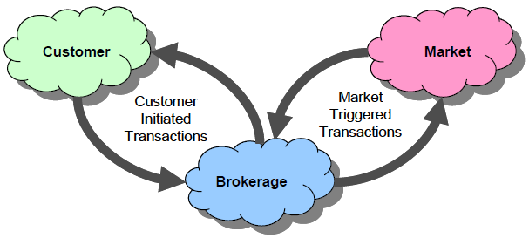
TPC-E Overview (2)
Business Model – Financial Market

Slide 9
TPC-E Overview (3)
Business Model – Financial Market
Driver
SUT

Slide 10
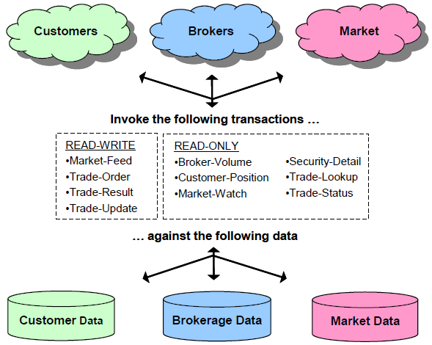
TPC-E Overview (4)
Business Model – Financial Market

Slide 11



TPC-E Overview (5)
Business Model – Comparison with TPC-C
TPC-C
Wholesale supplier
Organized by
  Warehouses
    Districts
      Customers
TPC-E
Brokerage House
Organized by
  Customers
    Accounts
    Securities
    Companies

Slide 12
TPC-E Overview (6)
Database Schema – Comparison with TPC-C

Slide 13
TPC-E Overview (7)
Database Tables and Scaling

Slide 14
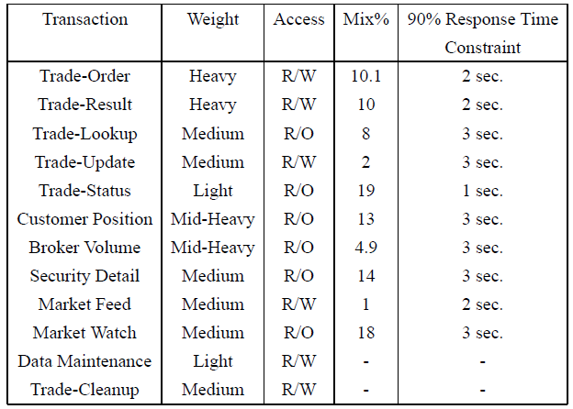
TPC-E Overview (8)
Transactions

Slide 15
TPC-E Overview (9)
Metrics
  Performance (throughput), expressed in tpsE
  Price/Performance, expressed in price/tpsE
  Availability Date, when all products necessary to achieve the stated performance will be available

Slide 16
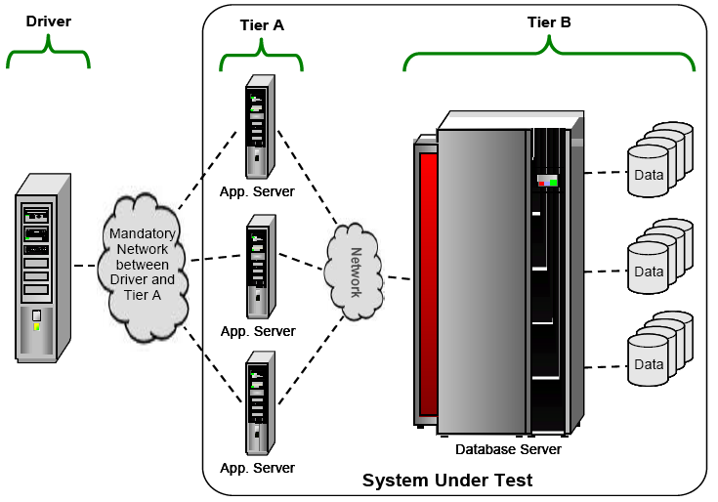
TPC-E Overview (10)
Sample Test Configuration

Slide 17
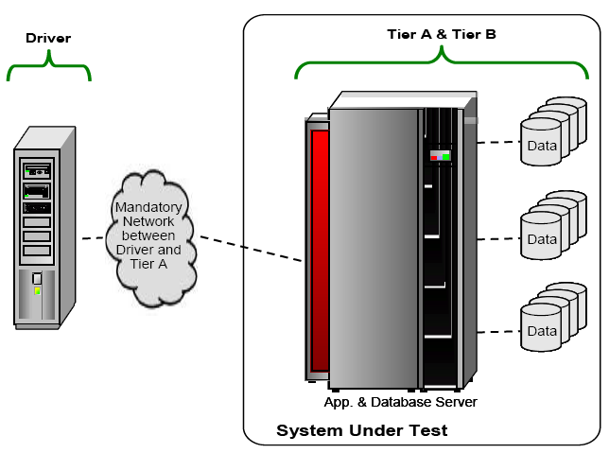
TPC-E Overview (11)
Sample Test Configuration, Variation I

Slide 18
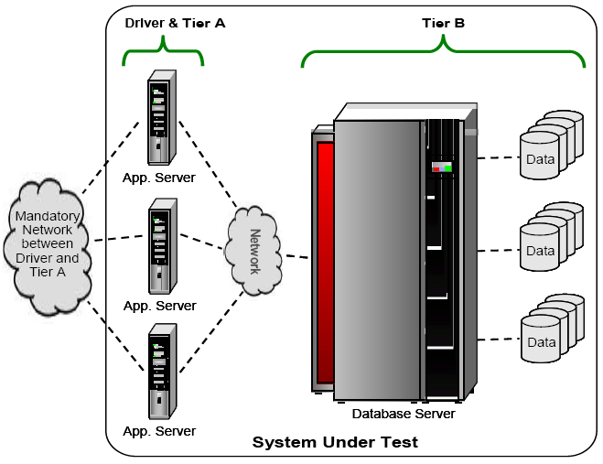
TPC-E Overview (12)
Sample Test Configuration, Variation II

Slide 19
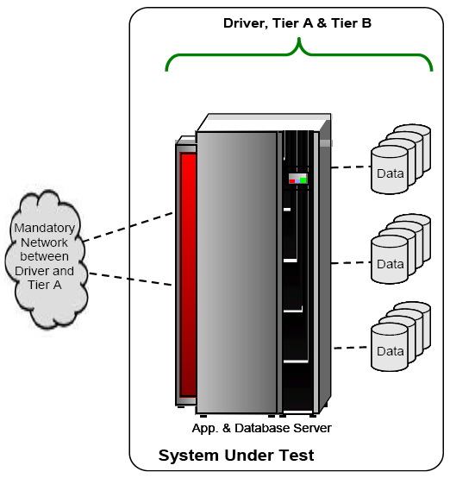
TPC-E Overview (13)
Sample Test Configuration, Variation III

Slide 20
TPC-E Overview – Highlights and Benefits
Financial business model
Rich transaction set
Diverse, realistic schema
Server-centric workload with DB focus
Realistic application model
Rebalanced hardware configuration
Specification provides code where sponsor creativity is not being tested

Slide 21
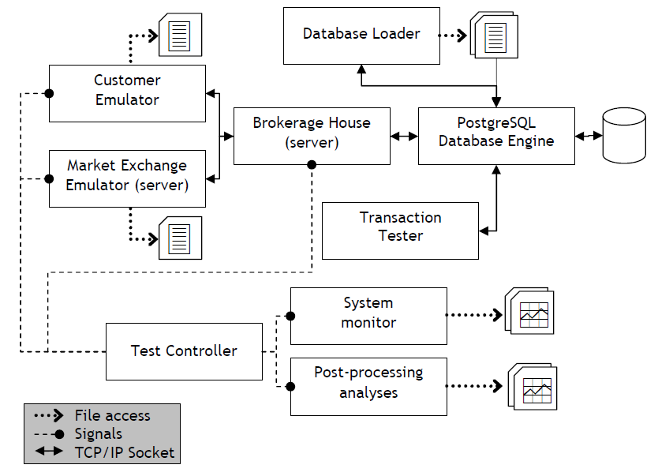
DBT-5 Architecture

Slide 22
DBT-5 Architecture - Loader
Database creation is vendor specific, but...
Database population can be vendor neutral
TPC-E includes a data generator for database loading
  C++ code to generate data
  Flat file generation is provided
  Sponsor is free to create to customize interface
Libpqxx: C++ API for PostgreSQL

Slide 23
Experimental Results
Test bed
  Processor: Intel(R) Xeon(TM) CPU 2.80GHz w/HT
  Memory: 3 GB
  Disk: 14 disks in hw RAID 0 (data)
  Operating System: Linux 2.6.20-gentoo-r4
  Database Engine: PostgreSQL 8.2.3
  Database Size: 2806 MB (1000 customers, 50 ITD)

Slide 24
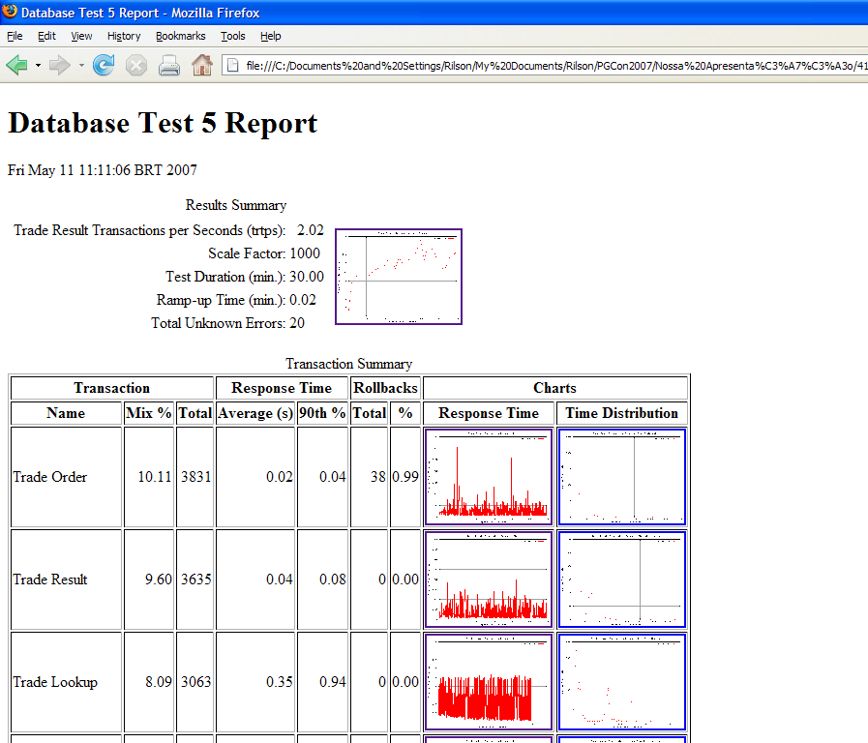
Experimental Results – DBT-5 Report

Slide 25
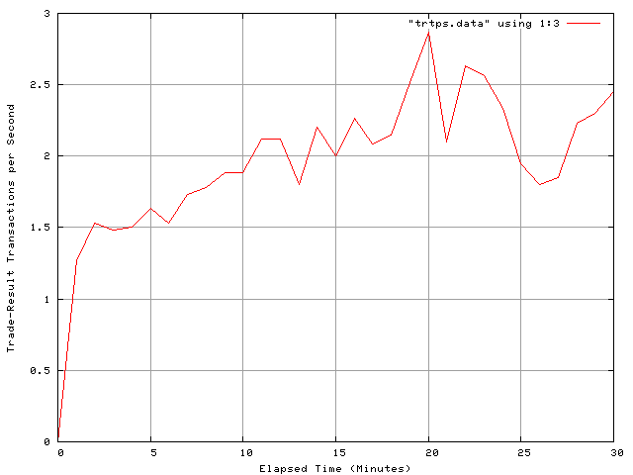
Experimental Results
Response Time (s)
Transaction % Average : 90th % Total Rollbacks %
----------------- ----- ----------------- ----------- ----------- ------
Trade Order 10.21 0.021 : 0.043 3869 38 0.99
Trade Result 9.59 0.040 : 0.083 3635 0 0.00
Trade Lookup 8.08 0.346 : 0.945 3063 0 0.00
Trade Update 1.96 0.313 : 0.677 743 0 0.00
Trade Status 19.03 0.006 : 0.010 7212 0 0.00
Customer Position 12.89 0.005 : 0.009 4885 0 0.00
Broker Volume 4.84 0.003 : 0.004 1835 0 0.00
Security Detail 14.43 0.014 : 0.018 5467 0 0.00
Market Feed 0.96 0.055 : 0.090 363 0 0.00
Market Watch 17.99 0.009 : 0.017 6817 0 0.00
Data Maintenance n/a 0.036 : 0.122 9 0 0.00
----------------- ----- ----------------- ----------- ----------- ------
2.02 trade-result transactions per second (TRTPS)
30.0 minute duration
20 total unknown errors
1 second(s) ramping up

Slide 26
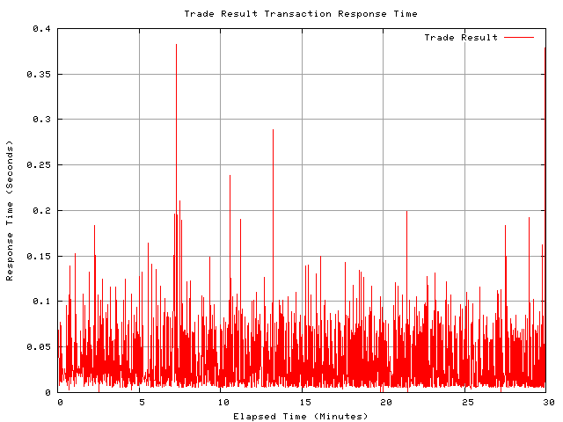
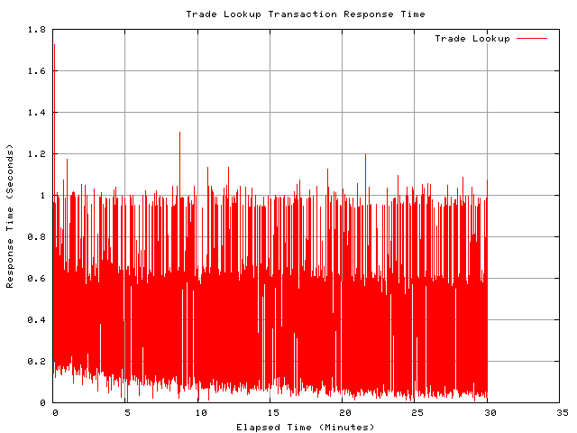
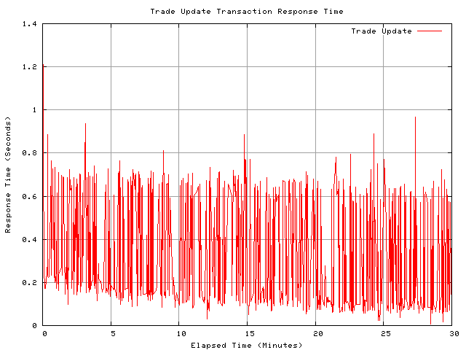
Experimental Results – Response Time Plots

Slide 27
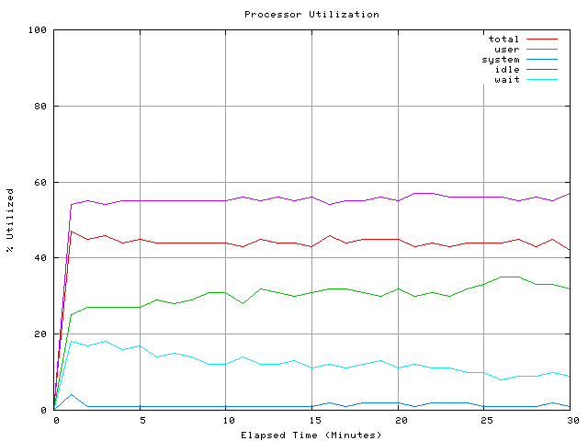
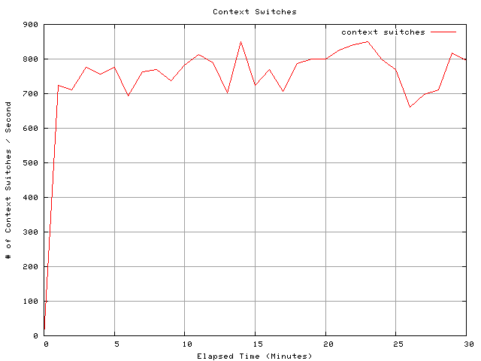
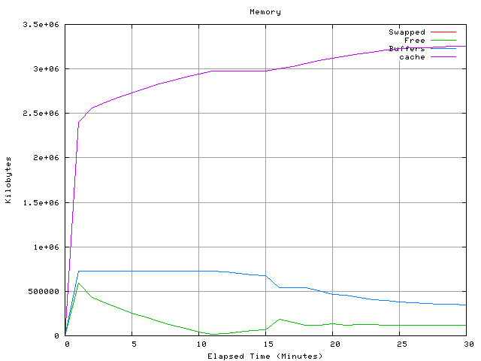
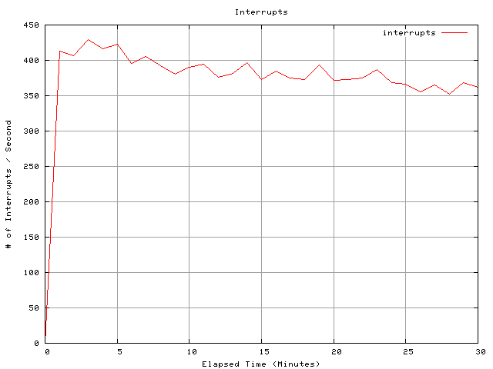
Experimental Results – System Statistics

Slide 28
Research
A scientific article portraying DBT-5 was accepted in the 27th Brazilian Computer Society Conference, that will be held in Rio de Janeiro in June 2007
  http://www.sbc.de9.ime.eb.br/en/index.php?view=wperformance&from=eventos&lang=en
Rilson's Master's dissertation is employing DBT-5: Synthesizing Representative I/O Workloads for TPC-E

Slide 29
Future Work
Update the workload to the latest TPC-E specification
  EGen
  Functions
Write the Functions in C (in progress)
Tune indexes/functions
Support other databases

Slide 30
Resources
DBT-5
svn co https://osdldbt.svn.sourceforge.net/svnroot/osdldbt/trunk/dbt5 dbt5
libpqxx: C++ API for PostgreSQL
http://pqxx.org/
TPC-E Specification
http://www.tpc.org/tpce/spec/TPCE-v0.32.2g.pdf (PDF)
http://www.tpc.org/tpce/spec/TPCE-v0.32.2g.doc (DOC)

Slide 31
Bibliography
TPC BENCHMARK™ E Standard Specification Version 1.0.0
TPC Site - www.tpc.org
Do Nascimento, R. O., M. Wong and P. R. M. Maciel. DBT-5: A Fair Usage Open Source TPC-E Implementation for Performance Evaluation of Computer Systems. XXVII Brazilian Computer Society Conference, 2007. (to appear)

Slide 32
Thank you! :)
    markwkm@gmail.com
  rilson.nascimento@gmail.com
    PGCon 2007, Ottawa

